Slide 1
“ College Name ”
A PROJECT ON
“MOVIE TICKET BOOKING SYSTEM”
As a partial fulfilment for the degree of Bachelor Of Computer Application (B.C.A)
Academic Year : 2022-23.
SUBMITTED BY:-
ABC
PQR
XYZ
GUIDED BY:-
ASST. PROF. ___

Slide 2
Table Of Contents :-
Introduction
Key Features
ConfiguRation
Technologies
Diagrams
Ui design
Lead and boost
references

Slide 3
INTRODUCTION:-
TICKZY is a place where User can book movie ticket of his/her favourite movie and admin can add latest movies show in the available theatres and screens.
It is developed using PHP Laravel and MySQL Server.

Slide 4
KEY FEATURES :-
Features for Users:-
Easy To Use :
User can easily Book Tickets from their Desktop because of User Friendly Navigation.
Portability :
User can easily download Booking details from Website.

Slide 5
KEY FEATURES :-
Features for Users:-
Flexibility :
Website provides facility for User to Book Tickets 24*7 from anytime, anywhere.
Integrity :
User’s data are safe because only Administrator has rights to access the data. User can’t access anything without authentication.

Slide 6
KEY FEATURES :-
Features for Admin:-
Easy To Use :
Admin can easily access admin panel from their Desktop because of User Friendly Navigation.
CRUD Facility :
Admin have create, read, update and delete access for Movies, Multiplexes, Screens and Movie Shows, and read, search and delete access for Users.

Slide 7
CONFIGURATION :-
User side configuration:-
Hardware : RAM – 8 GB above
Processor – Intel i5 or above
Hard Disk – 1 TB or above
Software : OS – Windows 11
Required – Internet Connection
Browser – Chrome, Edge, and others

Slide 8
CONFIGURATION :-
ADMIN side configuration:-
Hardware : RAM – 8 GB above
Processor – Intel i5 or above
Hard Disk – 1 TB or above
Software : Platform – PHP Laravel
Database – MySQL Server
Browser – Chrome, Edge, and others. Editor – VS Code

Slide 9
TECHNOLOGIES :-
Technology Stack :-
Frontend :
In Frontend Tickzy use PHP Laravel, Also use HTML5, CSS3, JavaScript, jQuery, and AJAX.
Backend :
In Backend, Tickzy use MySQL Server.

Slide 10
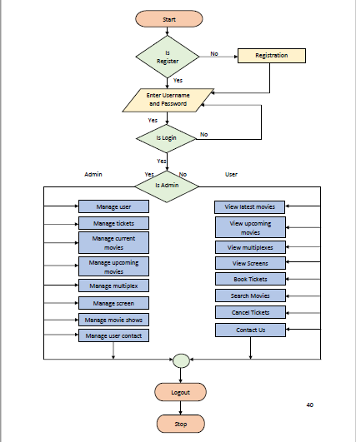
DIAGRAMS :-
SYSTEM FLOW CHART :-

Slide 11
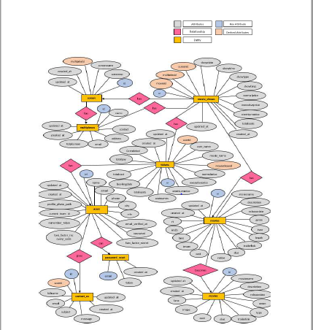
DIAGRAMS :-
ER DIAGRAM :-

Slide 12
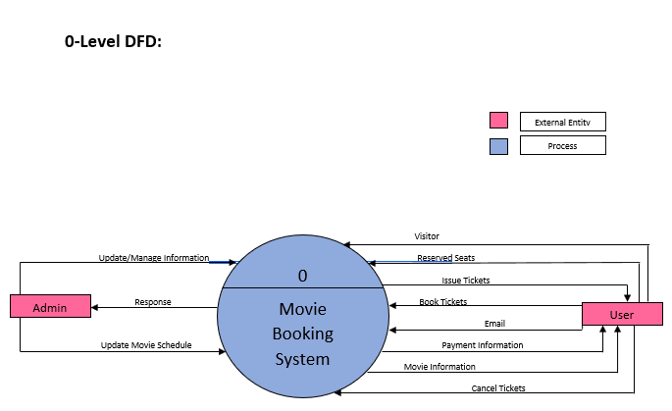
DIAGRAMS :-
0 – Level DFD :-

Slide 13
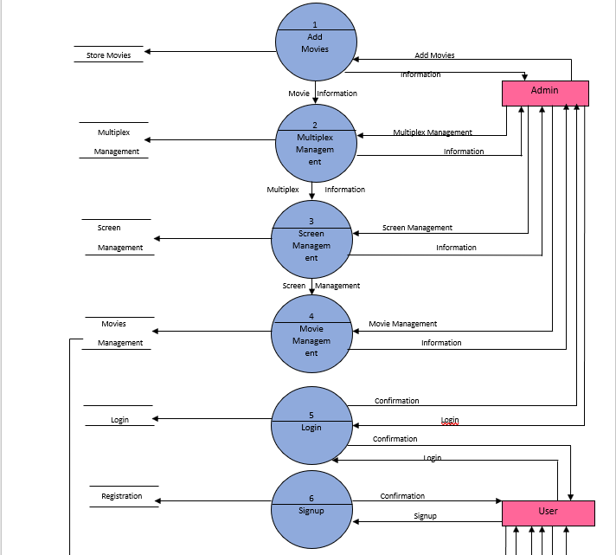
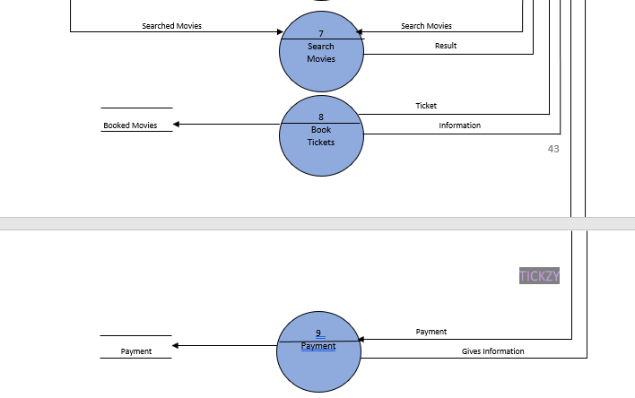
DIAGRAMS :-
1 – Level DFD :-

Slide 14
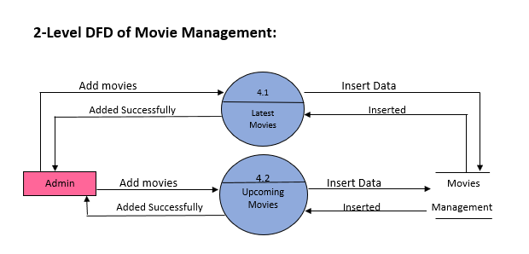
DIAGRAMS :-
2 – Level DFD OF MOVIE MANAGEMENT :-

Slide 15
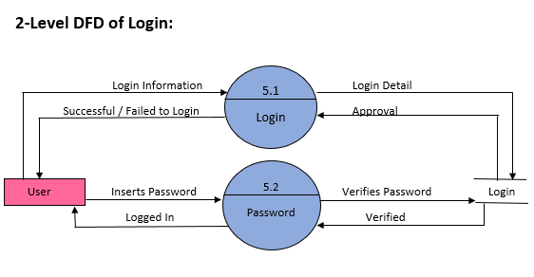
DIAGRAMS :-
2 – Level DFD OF login:-

Slide 16
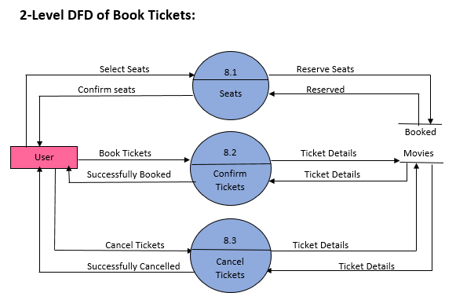
DIAGRAMS :-
2 – Level DFD OF book tickets:-

Slide 17
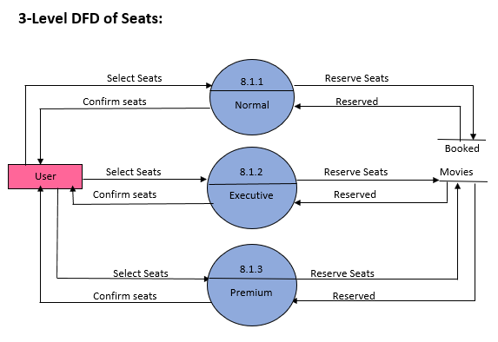
DIAGRAMS :-
3 – Level DFD OF seats:-

Slide 18
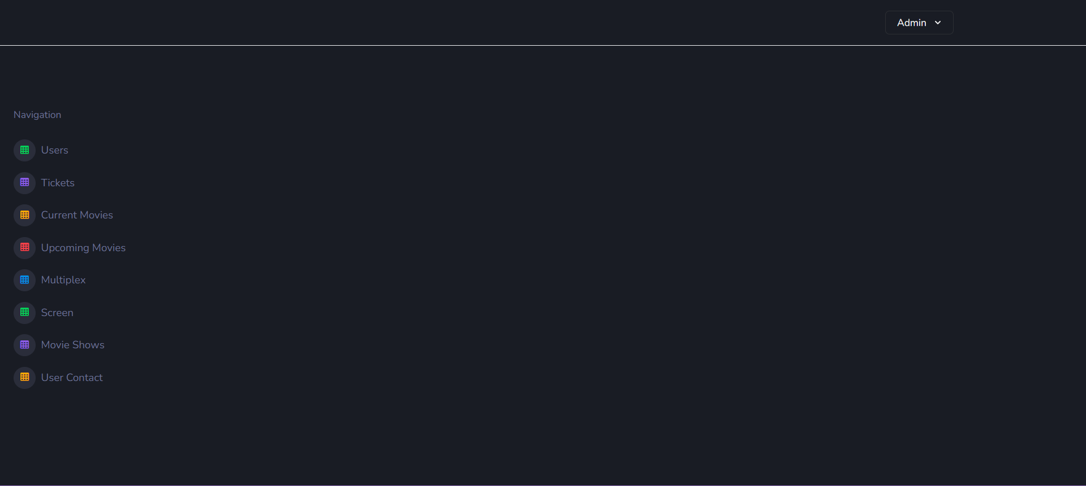
UI DESIGN :-
ADMIN PANEL :-

Slide 19
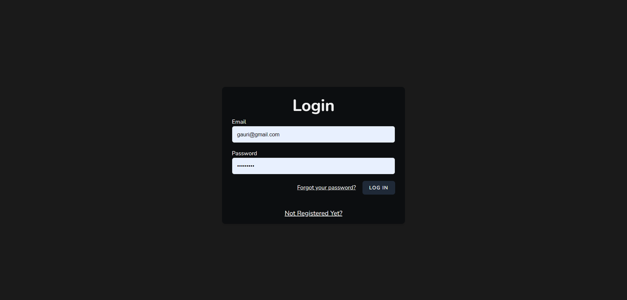
UI DESIGN :-
LOGIN :-

Slide 20
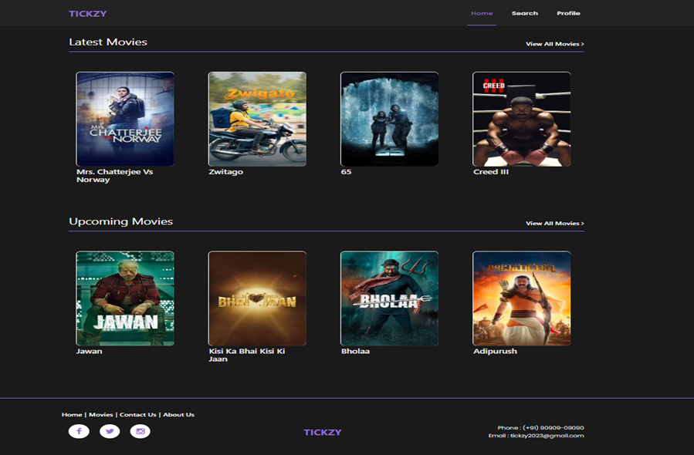
UI DESIGN :-
home :-

Slide 21
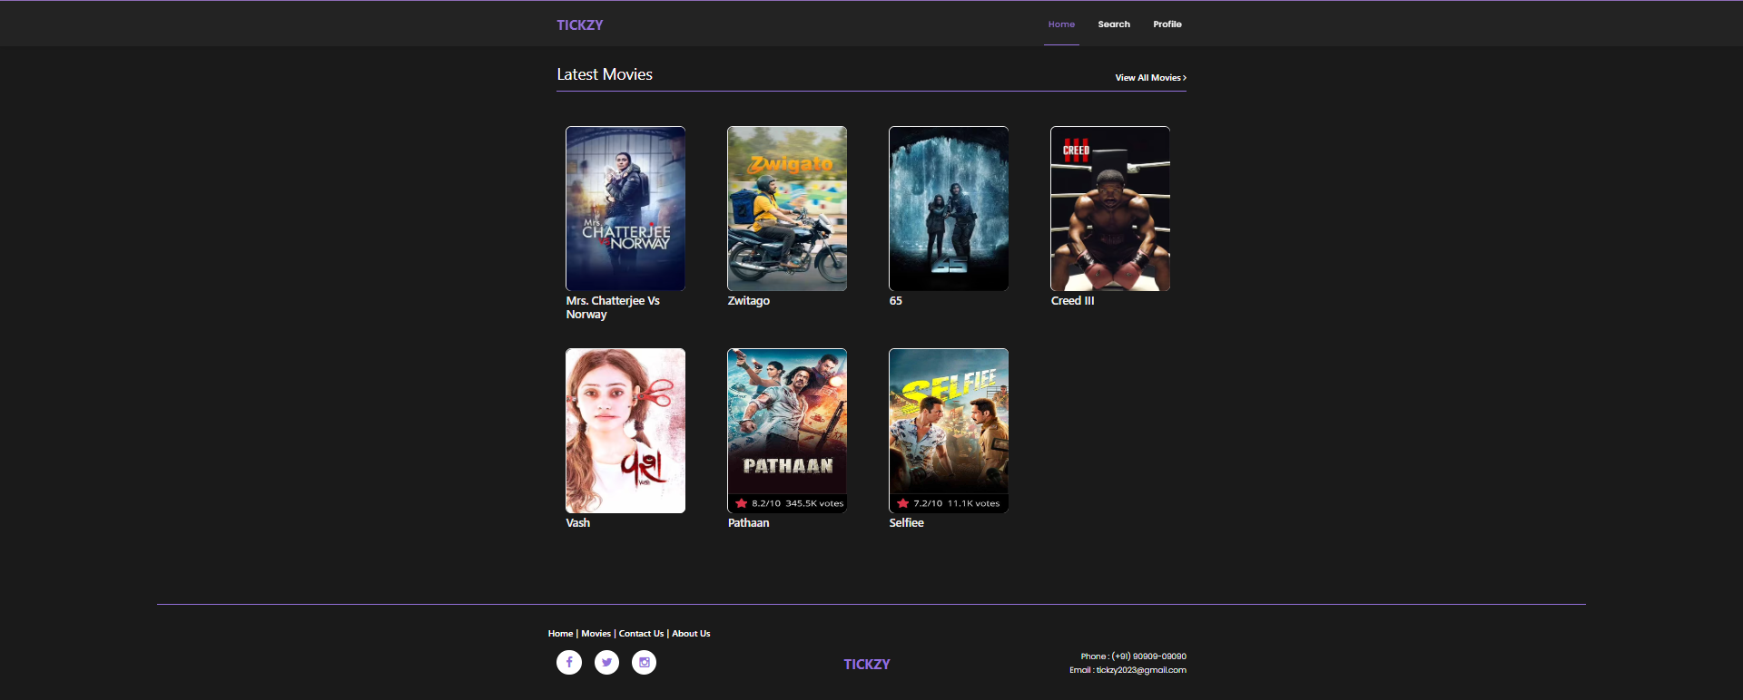
UI DESIGN :-
Latest movies :-

Slide 22
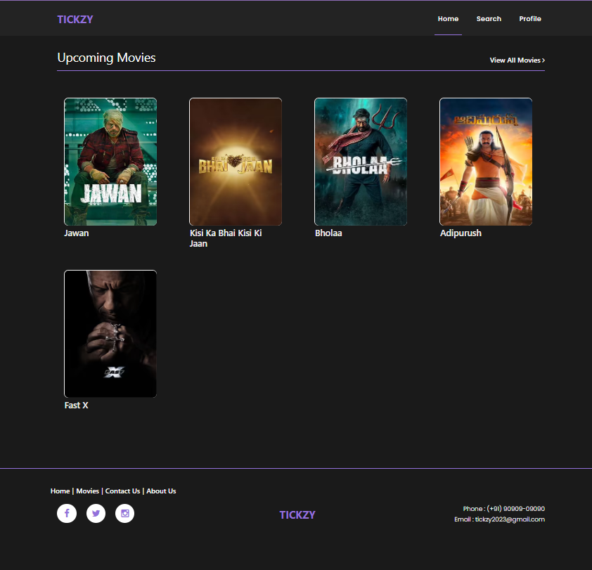
UI DESIGN :-
Upcoming movies :-

Slide 23
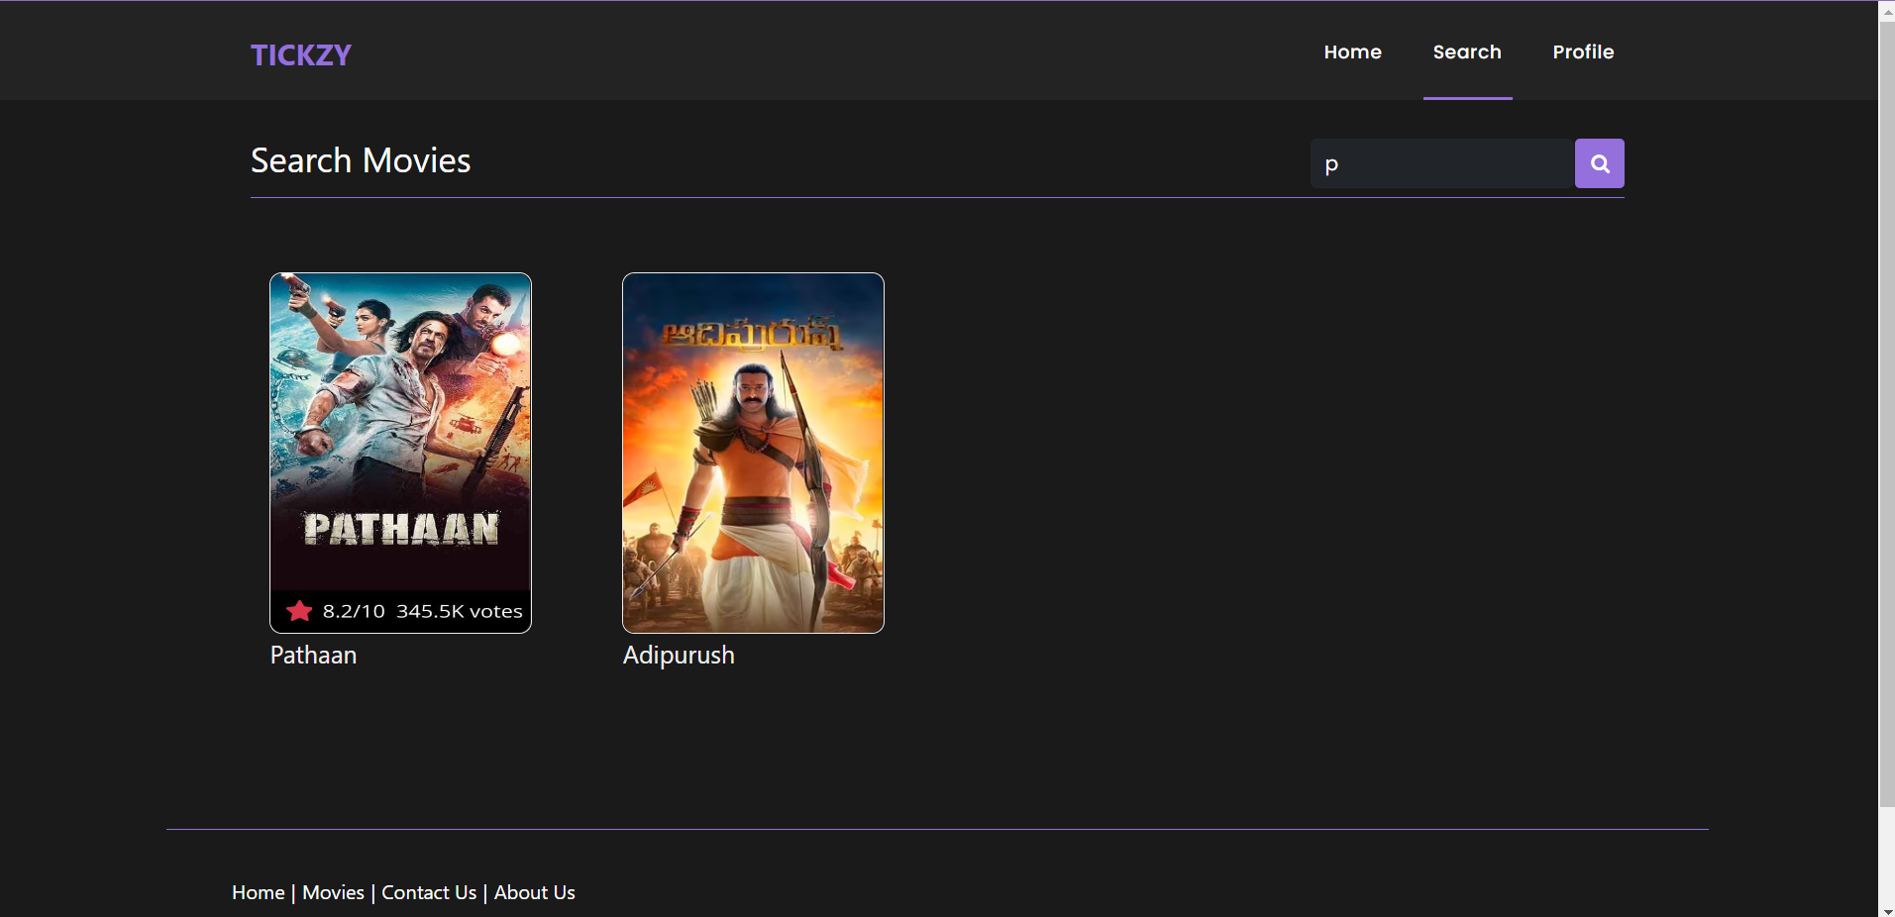
UI DESIGN :-
search movies :-

Slide 24
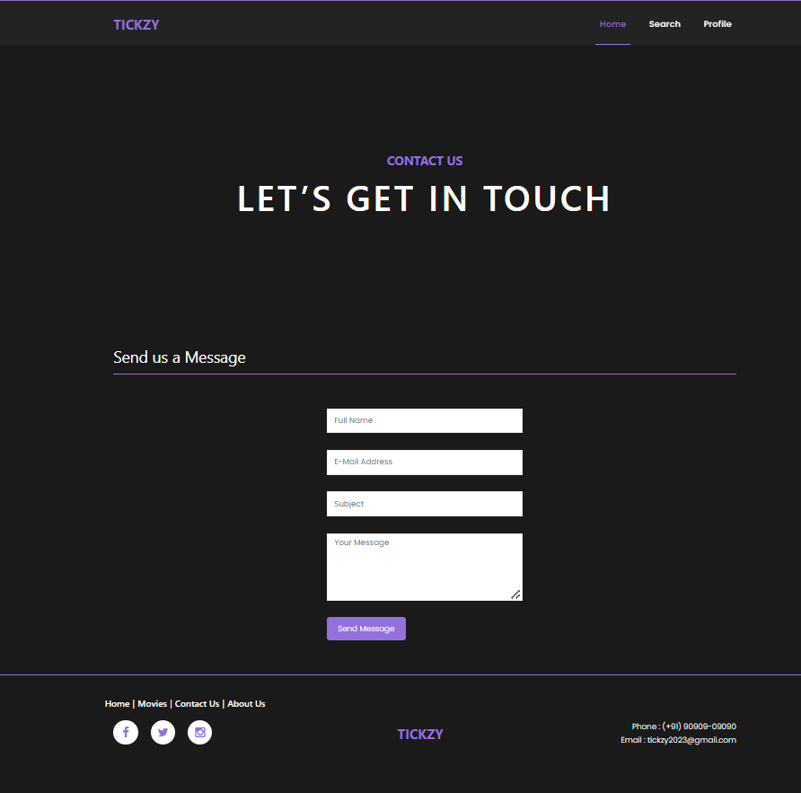
UI DESIGN :-
contact us :-

Slide 25
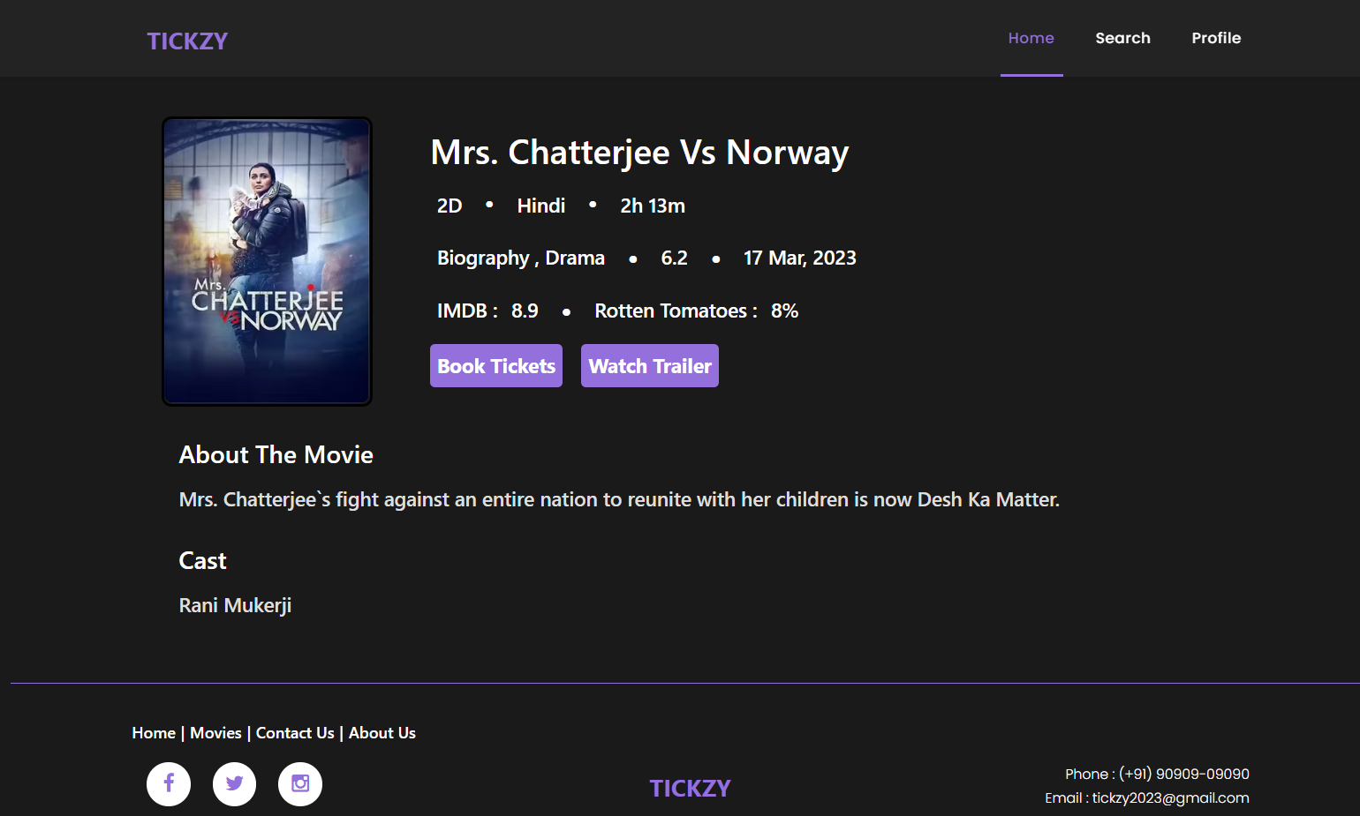
UI DESIGN :-
MOVIE :-

Slide 26
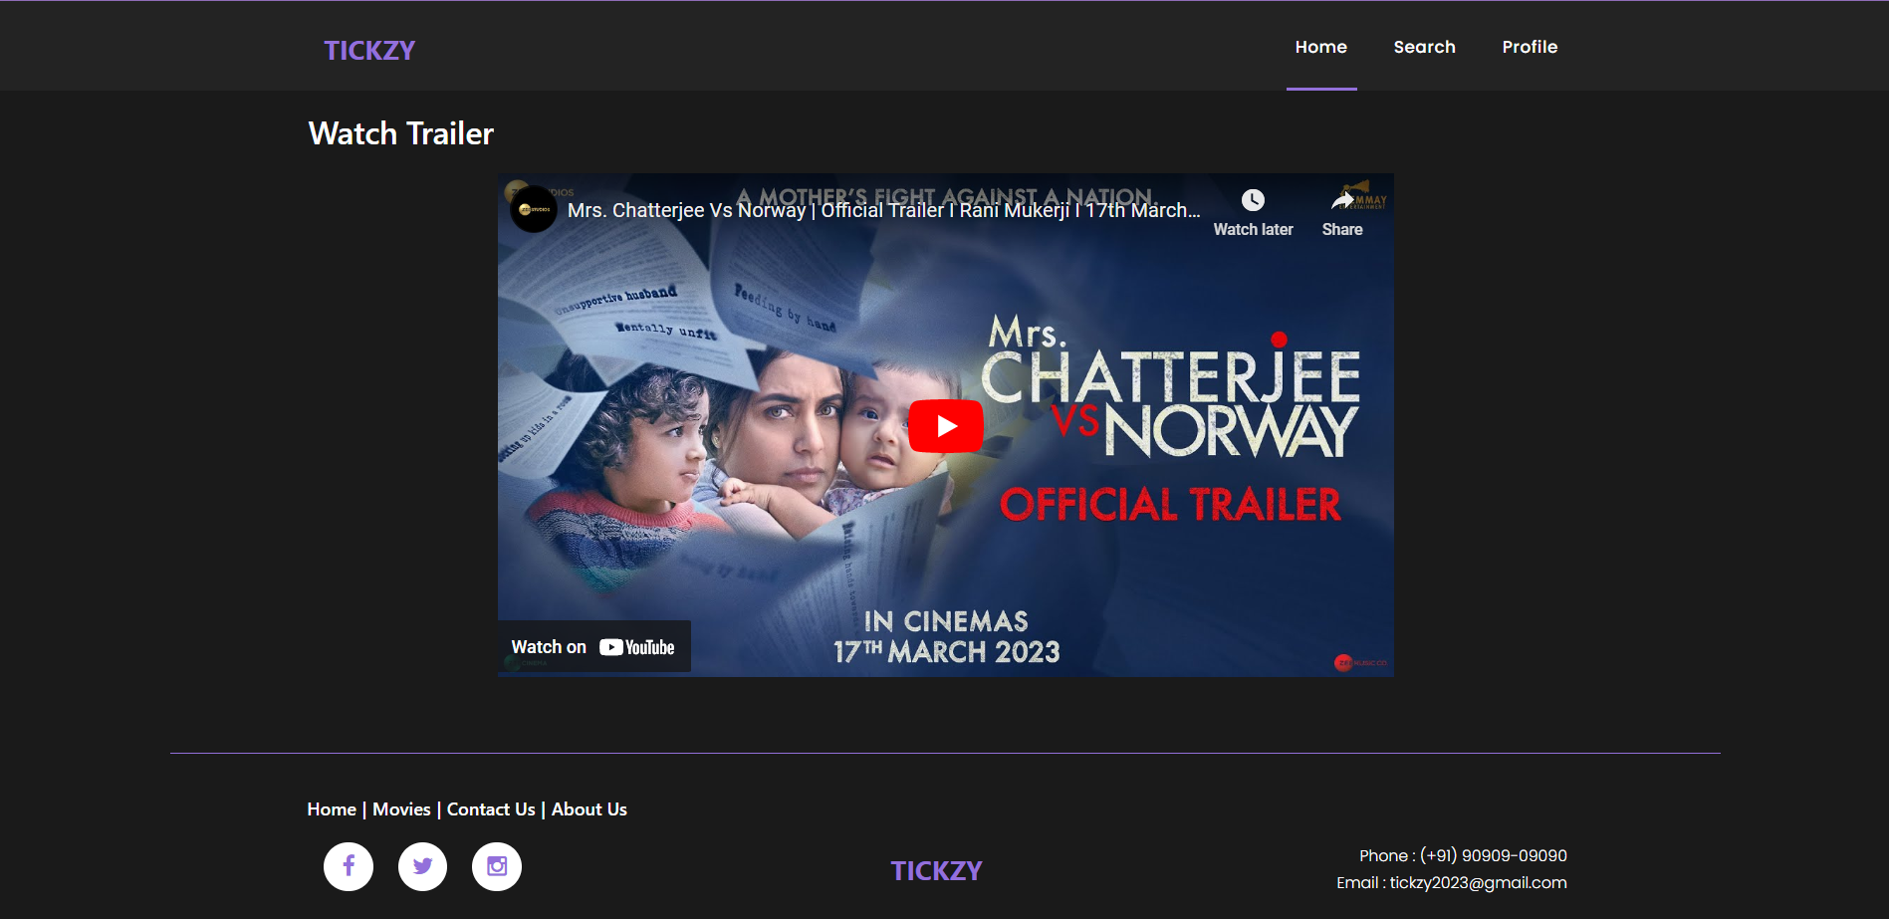
UI DESIGN :-
Watch trailer :-

Slide 27
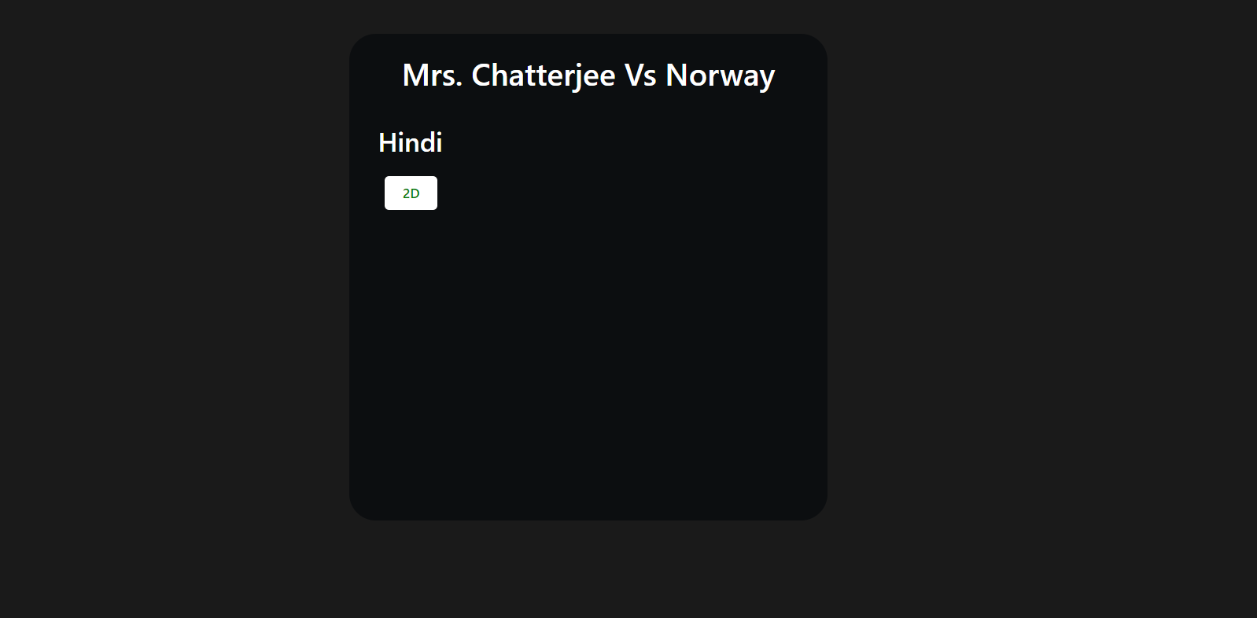
UI DESIGN :-
SELECT language :-

Slide 28
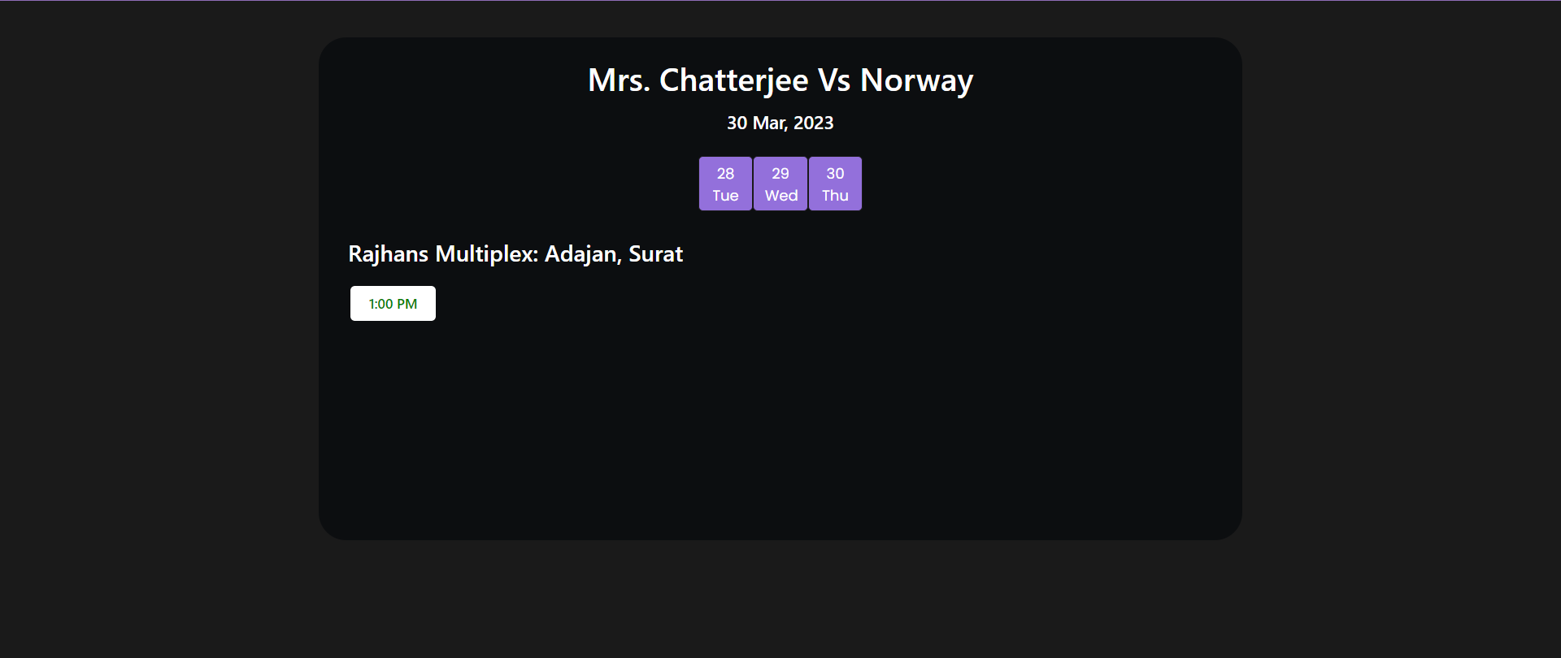
UI DESIGN :-
SELECT Showtime:-

Slide 29
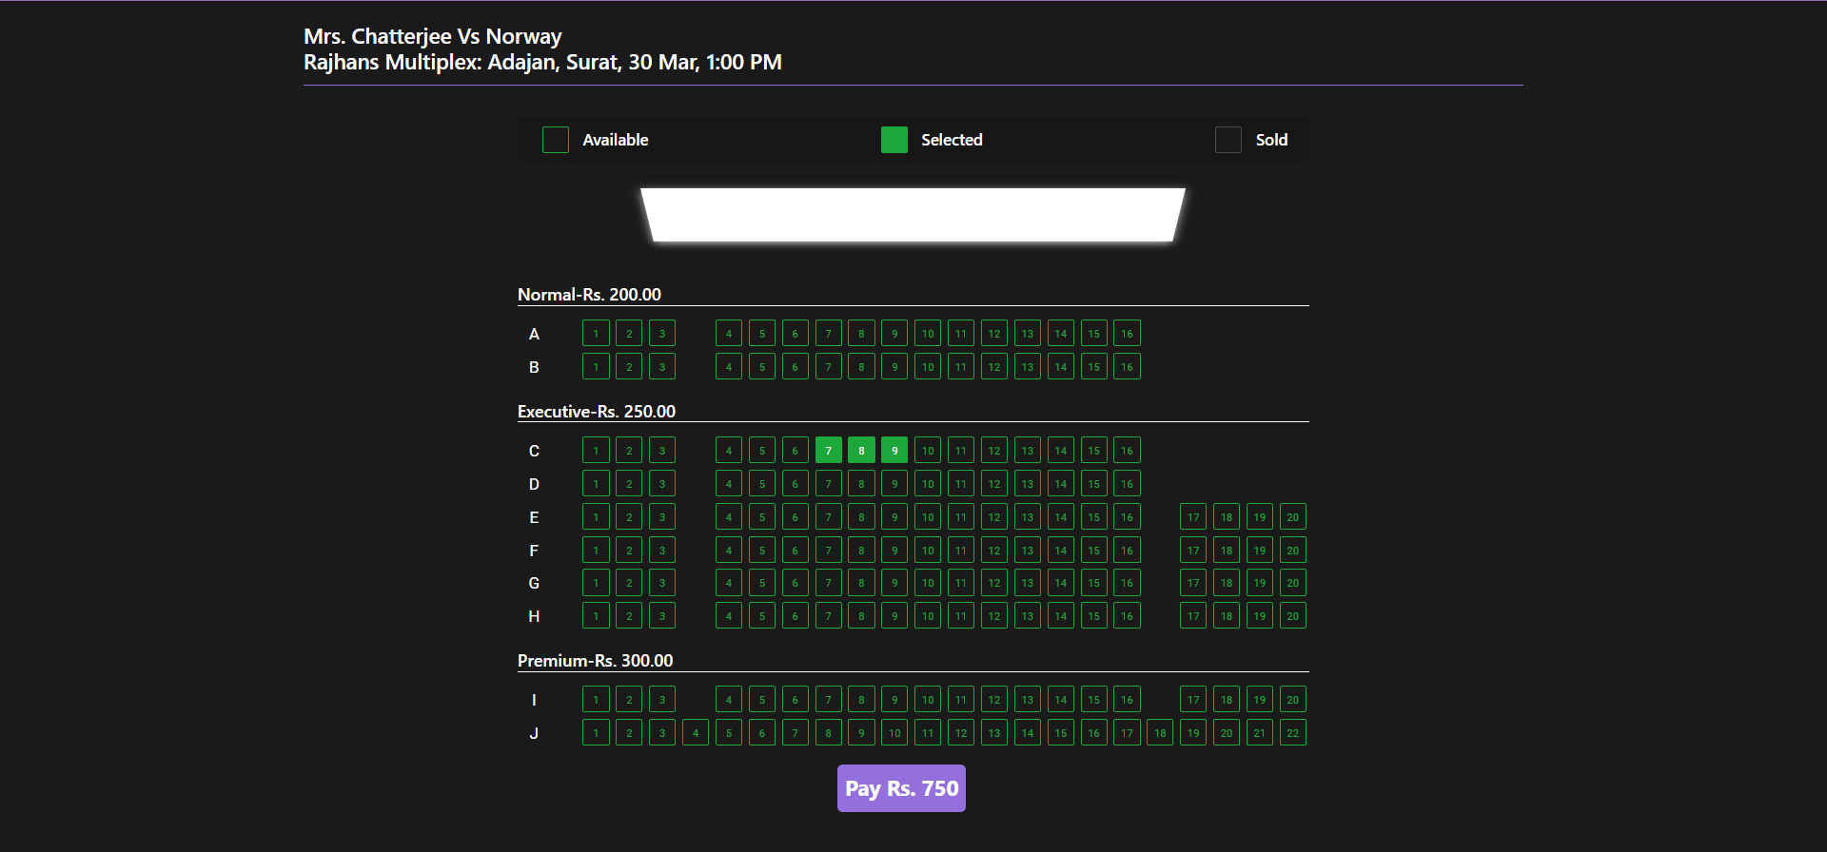
UI DESIGN :-
SELECT Seats:-

Slide 30
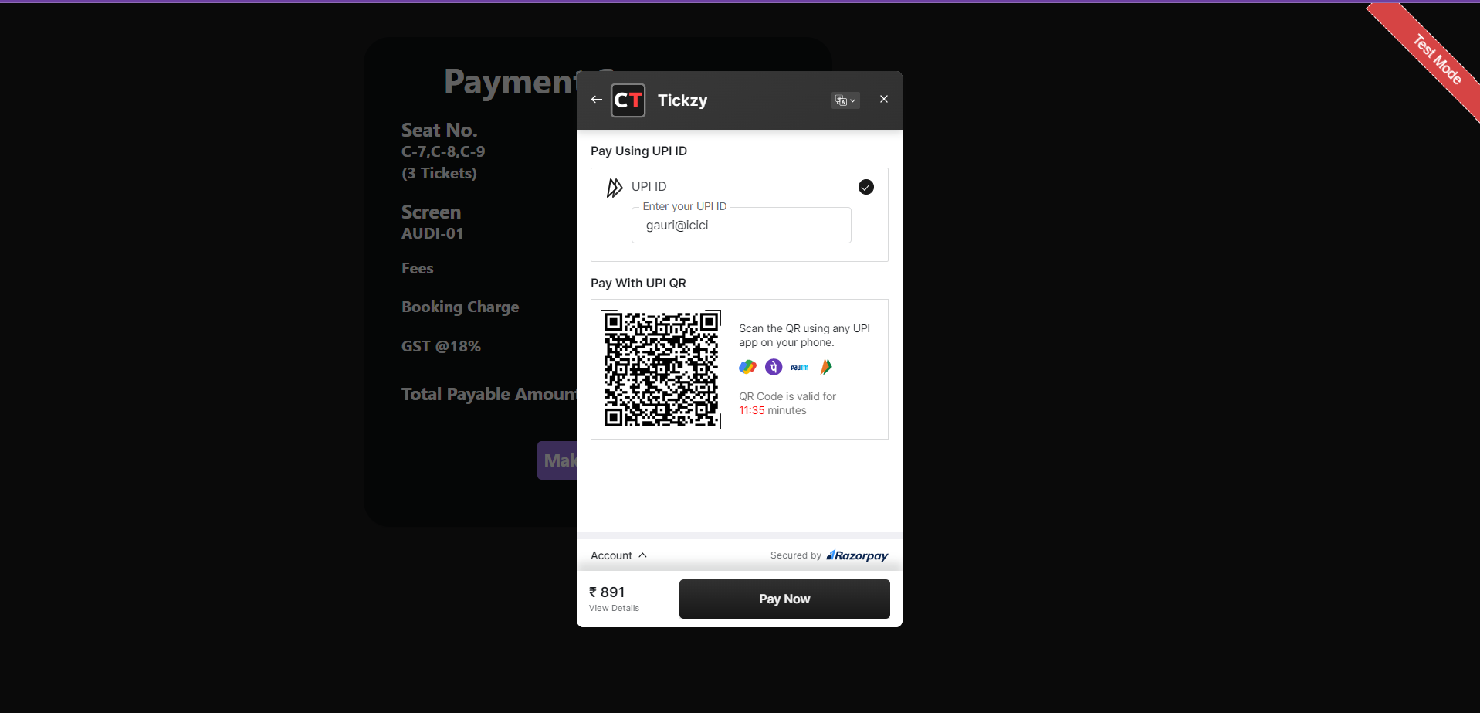
UI DESIGN :-
Razorpay payment:-

Slide 31
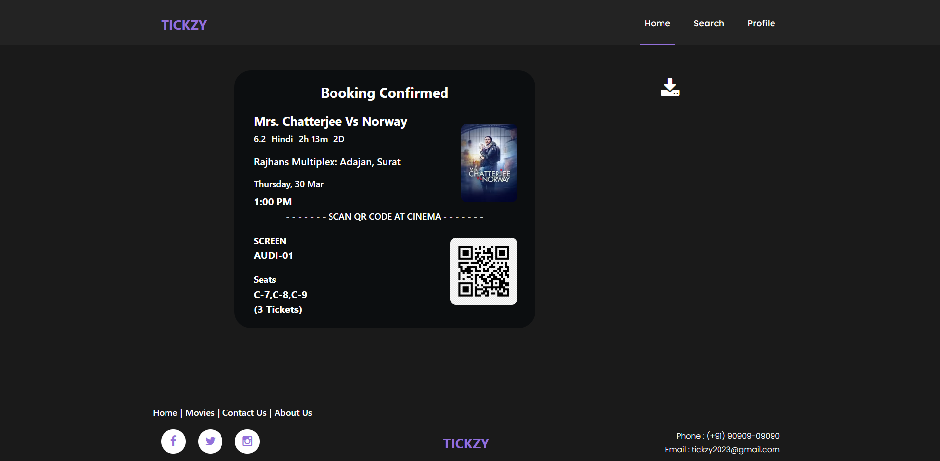
UI DESIGN :-
Payment success:-

Slide 32
LEAD AND BOOST:-
ADVANTAGES :-
Provides Facility for Movie Ticket Booking
Booking from anytime and anywhere
Latest and Upcoming Movies Details
Watch Trailer Option
Advance Booking
Ticket Details Download
Cancel Ticket Option

Slide 33
LEAD AND BOOST:-
DisADVANTAGES :-
Internet Handling Charges
User cannot choose City for current use
User cannot Customize theme on their Profile Page
User cannot use Coupons for current use

Slide 34
LEAD AND BOOST:-
Future enhancement :-
We will provide all Cities so that User can choose City.
We will provide Coupons Service so that User can get Extra Discount.
Add Profile Customize Themes for User to make their Profile attractive.

Slide 35
SPECIAL THANKS:-
We would like to take the opportunity to thank our college “ College Name ” for giving us this tremendous opportunity to work on this project.
Prof. ___, our professor and project coordinator, has been very prudent to us throughout our college studies. We express our regards to him from the core f our hearts.
We also like to thank our H.O.D. Prof. ___ and all the professors who are always ready t give the best guidance.

Slide 36
REFERENCES:-
PHP Documentation
Laravel Documentation
MySQL Documentation
JavaScript Documentation
HTML5 Documentation
CSS3 Documentation
jQuery Documentation
AJAX Documentation
Laravel 8
StackOverflow
Draw.io

Slide 37
Thank you.!
TICKZY
tickzy2023@gmail.com

